Slide 1
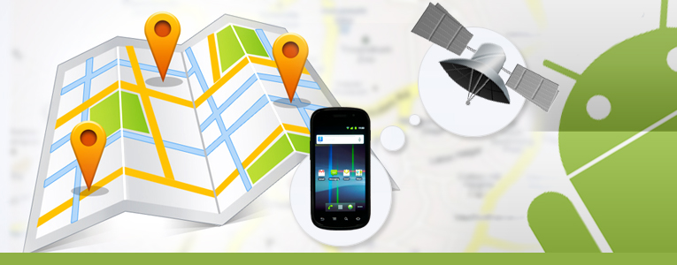
Where is who?!
Presented by:
Amira Mahmoud CS
Kholoud Reafat IS
Soaad Fathi IS
Supervised by:
Dr: Saleh Mesbah.

Slide 2
Agenda
Introduction.
Problem Statement.
Research Objectives.
Background.
Related Works.
Proposed System.
Experimental Work And Analysis
Conclusion.

Slide 3
Introduction
Presented By : Kholoud Refat

Slide 4
Introduction
Today's mobile devices are multifunctional devices capable of hosting a broad range of applications for both business and consumer use.
There are various types of services that mobile devices provide and our project provides one of these services which is location based services.
LBS is a service trying to find out the answer to “WHERE”, e.g. “Where am I?”; “Where is the restaurant?”; “Where are the target customers of our company”.

Slide 5
Cont..
Location-based services use a smartphone's GPS technology to track a person's location, if that person has opted-in to allow the service to do that. After a smartphone user opts-in, the service can identify his or her location down to a street address without the need for manual data entry.

Slide 6
Cont..
For example, LBS application could involve the following aspects:
People Tracking and Finder.
Driving Directions.
Recommending social events in a city.
Requesting the nearest business or service, such as restaurant .
Receiving alerts, such as notification of a warning of a traffic jam.

Slide 7
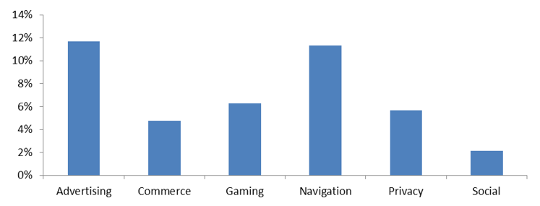

Slide 8
Problem Statement
Where is who ?? is the friend locator app., “Where is who?? ”’s GPS tracking data makes it easy to locate friends.
Consider two scenarios :
Will your habitually late friend make it to the movie on time? Use “Where is who ??” to pinpoint his/her exact location, so you can plan accordingly.

Slide 9
Cont..
Is your directionally challenged friend lost. It pinpoints your missing friend’s exact location and provides navigational help (i.e., directions) so you can guide them to their determined destination.
It’s the friend finder and friend locator that works.

Slide 10
Project Objectives
To propose mobile application that helps the user to locate their friends and relatives.
To provide requirements analysis and design models for the proposed system.
To develop an initial prototype for the proposed system.

Slide 11
Background
Presented by:
Soaad Fathi &
Amira Mahmoud

Slide 12
GIS
Geographic information systems (GIS) (also known as Geospatial information systems) are computer software and hardware systems that enable users to capture, store, analyze and manage spatially referenced data.
GIS can also help to achieve the overall objective of improving the decision making process, whether in an organization, or within a project.

Slide 13
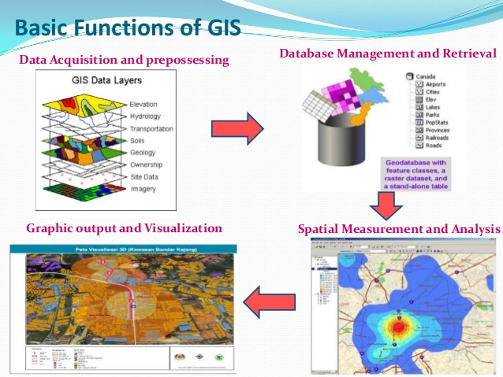

Slide 14
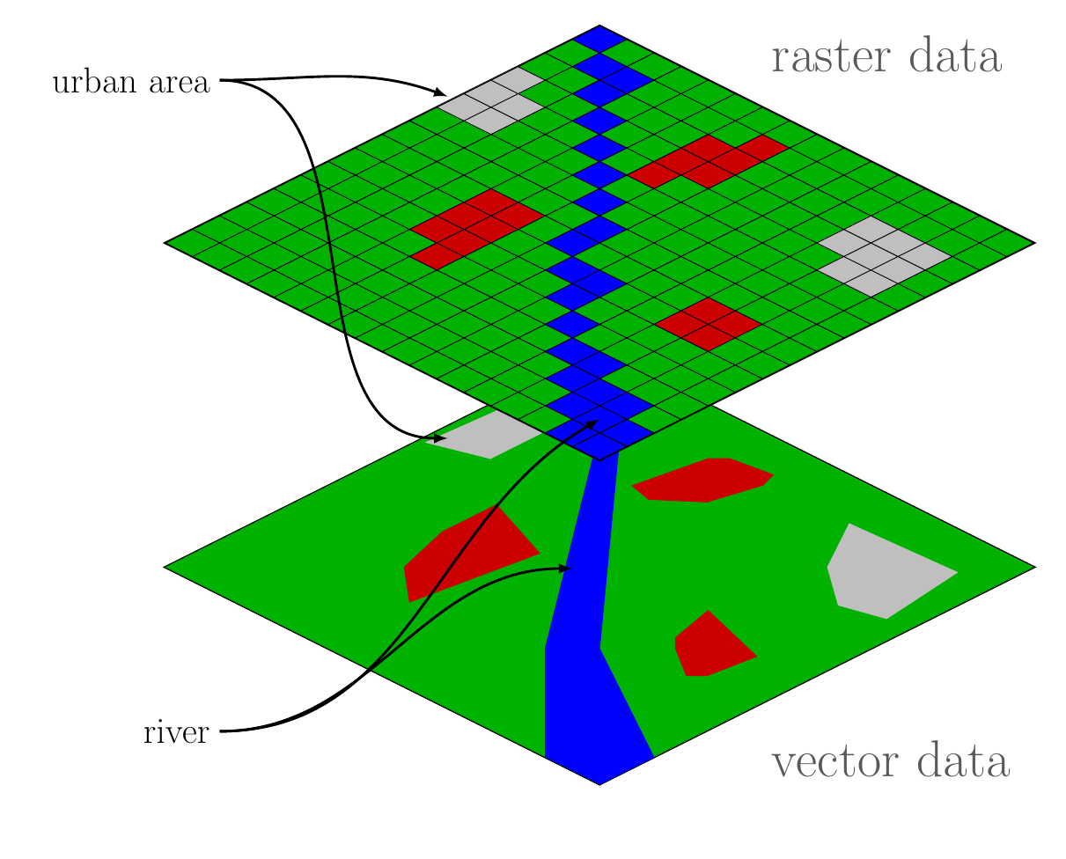
Data Types
Vector
Points
Lines
Polygons
Raster
Cell
Pixels
Elements

Slide 15
GPS
Stands for Global Positioning System.
“Global Positioning System is a space based satellite navigation system that provides location and time information in all weather conditions, anywhere on or near the Earth where there is an unobstructed line of sight to four or more GPS satellites.”

Slide 16
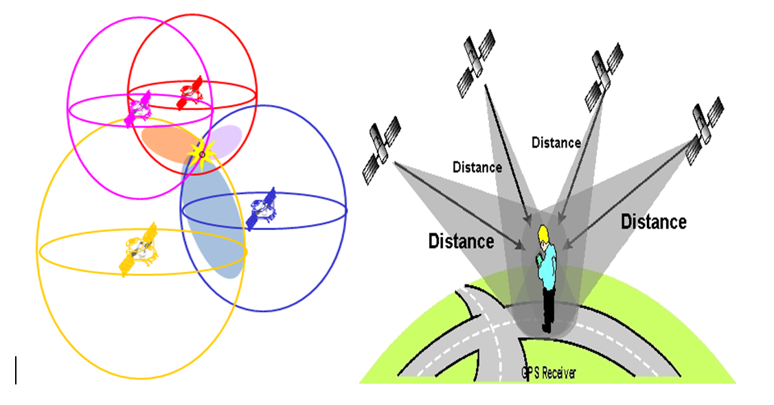
How it works ??

Slide 17
Basic concepts of GPS
A GPS receiver calculates its position by precisely timing the signals sent by GPS satellites high above the Earth.
Each satellite continually transmits messages that include
The time the message was transmitted
Satellite position at time of message transmission

Slide 18
Related work
university | year | paper
Dept of CSE, GMRIT, RAJAM Andhra Pradesh, India Dept of CSE, ANITS, Visakhapatnam Andhra Pradesh, India | 2013 | GPS Based Vehicle Navigation System Using Google Maps
University of South Florida | 2006 | A General Architecture in Support of Interactive, Multimedia, Location-Based Mobile Applications
Riyadh 11653, Saudi Arabia. |  | A GPS-based Mobile Dynamic Service Locator System

Slide 19
Related work
Vehicle Navigation System Using Google Maps
Mahmood, F.M. Ch.ChakradharaRao , P.Pushpalatha , Dept. of CSE, ANITS, Visakhapatnam Andhra Pradesh, India
Presented by :
Amira Mahmoud

Slide 20
It mainly focuses on developing an enhancement of GPS based vehicle navigation system using Google Maps.
Nowadays, one of the main problems with respect to public transport is management of buses. Their management involves a lot of problems to the authorities.
In this project, it is proposed to design an embedded application which is used for tracking and positioning of any vehicle by using Global Positioning System (GPS) and GSM/GPRS.

Slide 21
The current embedded application will continuously monitor a moving Vehicle and report the status of the Vehicle on demand or automatically.
When the request by user is sent to the number at the modem, the system automatically sends a return reply to that mobile indicating the position of the vehicle in terms of latitude and longitude.

Slide 22
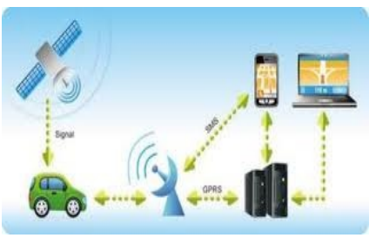
This tracking can also be automatically done without the intervention of the user and the track report is updated using GPRS (General Packet Radio Services).

Slide 23
Cont- Related work
Interactive, Multimedia, Location-Based Mobile Applications
Sean J. Barbeau, Miguel A. Labrador, Philip L. Winters, Rafael Pérez, and Nevine Labib Georggi, IEEE Communications Magazine • November 2006
By :
Soaad fathi.

Slide 24
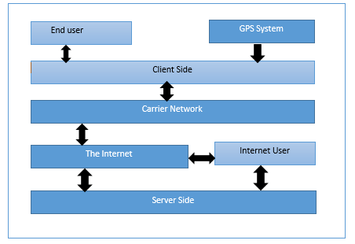
System architecture:

Slide 25
The four components:
THE CLIENT SIDE :
includes the end user, the GPS system and the end user device.
The Main Application is the software program that implements the desired service in the mobile device.
The Client Side software also includes a Graphical User Interface (GUI) so that the user can interact with the system.

Slide 26
Cont- four components:
2. THE CARRIER NETWORK
The Carrier Network, is the transport network that interfaces directly with the Client Side and the Internet.

Slide 27
Cont…
3. THE INTERNET:
The Internet is the transport network that allows users to interact with the applications anywhere at anytime.
This component, consists of three modules:
Email Server
Map Server .
Voice over IP (VoIP) Server

Slide 28
Cont..
4. THE SERVER SIDE
The Server Side, is the most complicated component of the architecture.
The architecture includes a Database Server used to messages, user and device profiles, specialty data for specific applications such as bus stops locations, bus routes, subscription lists, and a Geographical Information System (GIS) database used for comparing user-location information with geographic maps.

Slide 29
Cont…
This architecture facilitate the development of many personalized, multimedia, interactive, community-oriented applications that will add convenience and safety to people’s everyday lives.
The flexibility of the architecture is demonstrated by presenting the Wireless Safety Security System and other potential applications.

Slide 30
Related work
A GPS-based Mobile Dynamic Service Locator System.
Hassan I. Mathkour.
Department of Computer Science, King Saud University, Riyadh 11653, Saudi Arabia.
By:
Kholoud Reafat.

Slide 31
Cont…
A GPS-based Mobile Dynamic Service Locator System helps individuals in different walks of life to find addresses and to locate these services of interest using their mobile devices.
Required services may range from emergency locations, such as hospitals, clinics and pharmacies, or public and governmental services locations to private services locations, such as restaurants, shops, malls and etc.

Slide 32
Most applications in the market are not user friendly, do not provide precise data, nor allow multiple ways to access the data, such as SMS, web access and real time feed back to the requester.
The proposed system is meant to resolve such deficiencies.
It uses the cell phone service provider to locate the requester for a registered service. It is not necessary to have an Internet connection as the requester can use SMS to request a service location.

Slide 33
How the Communication works ?
1. The application sends SMS to cell phone service provider to request the current location.
2. The cell phone service provider sends an SMS back with the current location.
3. The application parses the SMS and then sends SMS to the services’ server to get the requested service location.
4. The server sends back an SMS with the requested service location.

Slide 34
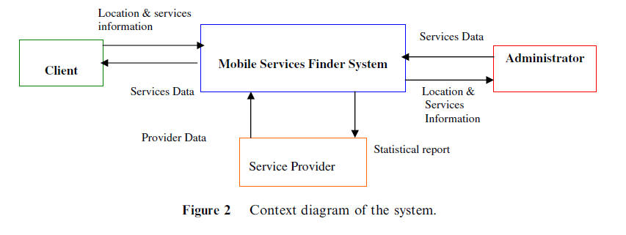
A client interface on mobile device allowing the user to request certain services from his current location.
A web interface on the server allowing the service provider to register, update its service information, and gather statistical data on clients requesting this service.
A desktop interface on the server allowing the system administrator to add, maintain and manage services and users on the system.

Slide 35
This proposed system determines the proximity distances between the user and the locations of the desired service. Thus the user has a valuable distance information that would be beneficial in his decision making process to select the most appropriate service.
The system is flexible and easily to corporate additional mobile service providers and new services.

Slide 36
Proposed System
By :
Kholoud Refat

Slide 37
Our proposed is a location based real-time mobile application.
The model consists of :
Client Side
Server Side

Slide 38
Proposed System : Client Side
Each user must have a smart phone with Android and GPS capability.
The user must install the application.
The user can’t track a person who is not using the application.
The app will be running on the background even if the user isn’t using the app.
The Application will consist of :
Login Form
Registration Form
Each user has a profile and can add and accept friends.

Slide 39
Proposed System : Server Side
Server database :
- Store the location and update every 3 minutes.
- Store the basic information of users.
Server System :
- Keep tracking the location of all users (Every three minutes will update the DB).
- Coordinate users’ requests.

Slide 40
Analysis & design
Functional requirements:
Login system.
Browsing of special information.
Location – based access.
Geographical view.

Slide 41
cont
Non-functional requirements:
Usability
Reliability
Privacy
Availability
integrity
Scalability

Slide 42
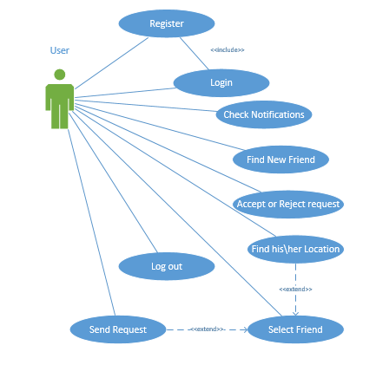
Use case diagram

Slide 43
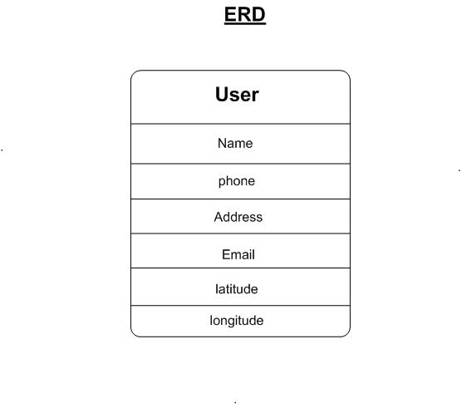

Slide 44
Experimental Work And Analysis

Slide 45
Overview about Backend & Parse.com
Presented by :
Soaad fathi

Slide 46
Backend as a service
Backend as a Service, is a cloud computing category that consists of companies that make it easier for developers to setup, use and operate a cloud backend for their mobile, tablet and web apps. Backend as a Service provides web and mobile app developers with a way to link their applications to backend cloud storage while also providing features such as user management, push notifications, and integration with social networking services.

Slide 47
Cont. backend
Cloud backend as a service platforms enable app developers to store, manage and access their data through such cloud. Moreover, they are able to develop backend features for their apps in minutes, rather than weeks.

Slide 48
Parse.com
Parse.com:
As we discussed before we will use Parse.com to help us make faster and more reliable application backend. So what is Parse.com?
The Parse platform provides a complete backend solution (Backend as a service) for your mobile application. Our goal is to totally eliminate the need for writing server code or maintaining servers.
The user first connects to parse.com then he can use parse features inn his/her application.
We will give a brief introduction about the functions that we used them in our application.

Slide 49
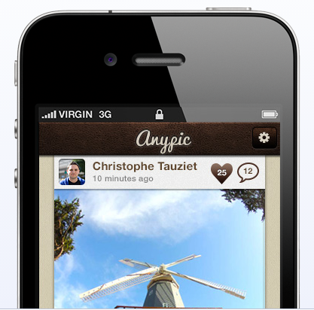
Applications Using Parse:
Anypic (iOS)
A social photo sharing app built on top of Parse that lets you share your pics with your friends.

Slide 50
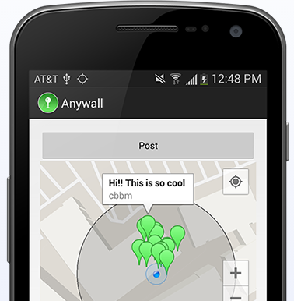
Anywall (iOS & Android)
A fun geolocation app powered by Parse which lets you post and view messages at physical locations

Slide 51
Where is who system using parse.com
Presented by :
Amira Mahmoud &
Kholoud Reafat

Slide 52
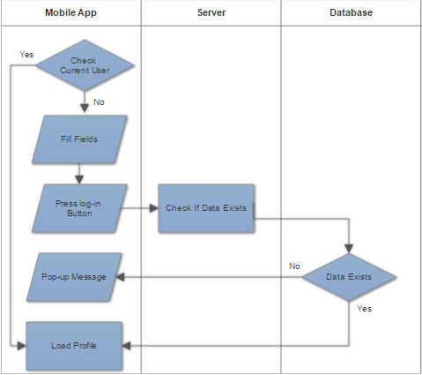
login

Slide 53
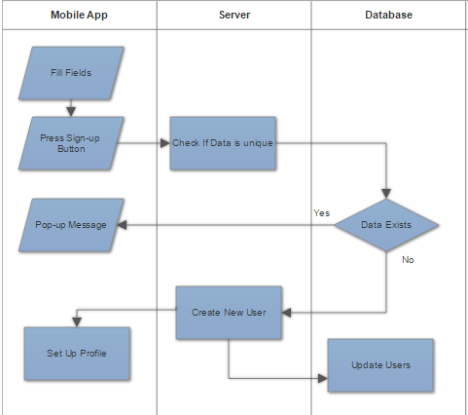
register

Slide 54
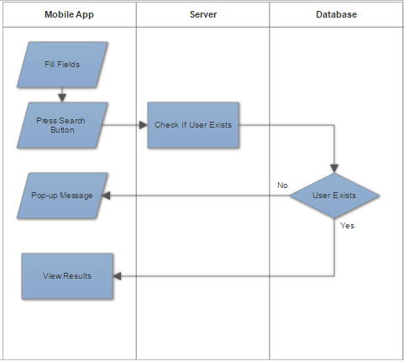
search

Slide 55
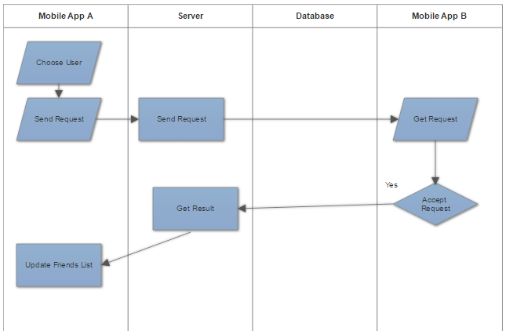
Add/reject friend

Slide 56
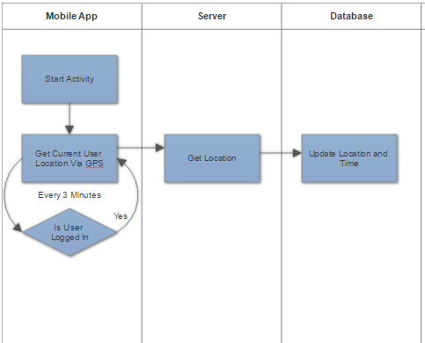
Main Activity

Slide 57
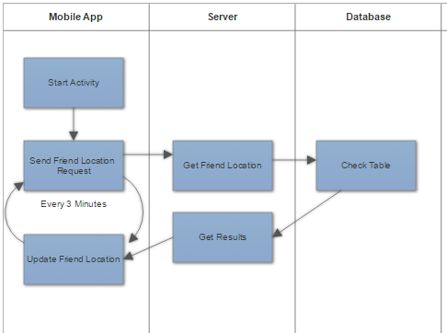
Con-Activity

Slide 58
App design
presented by :
Soaad Fathy
Amira Mahmoud

Slide 59
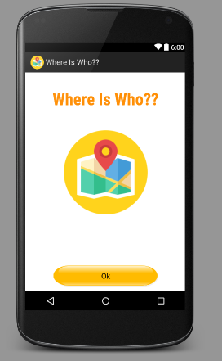
APP design
We start with the app design: we used xml along with drag and drop to design our software:

Slide 60
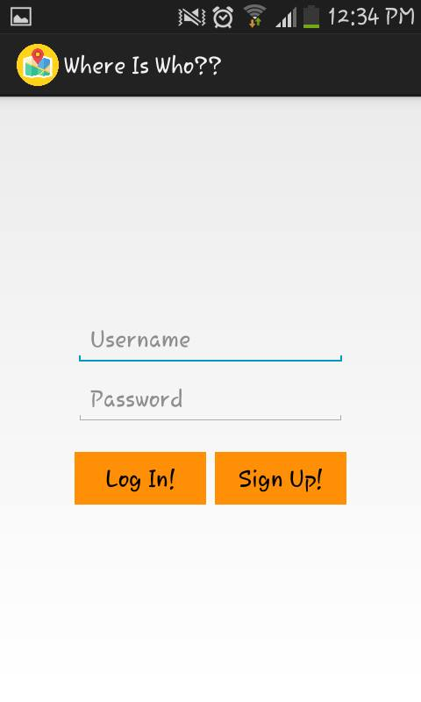

Slide 61
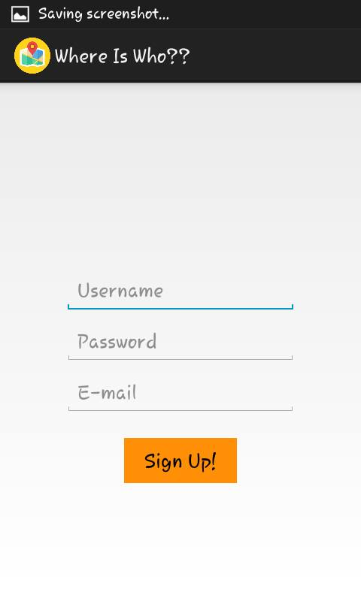

Slide 62
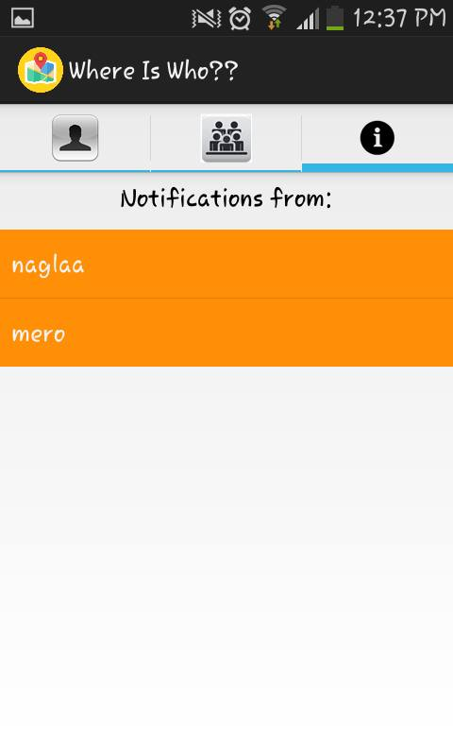

Slide 63
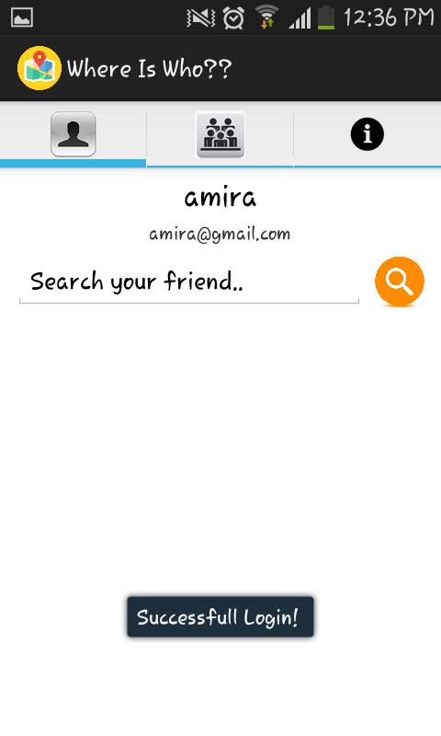

Slide 64
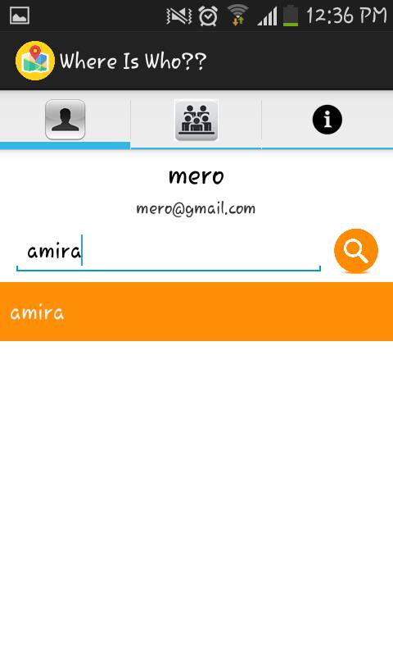

Slide 65
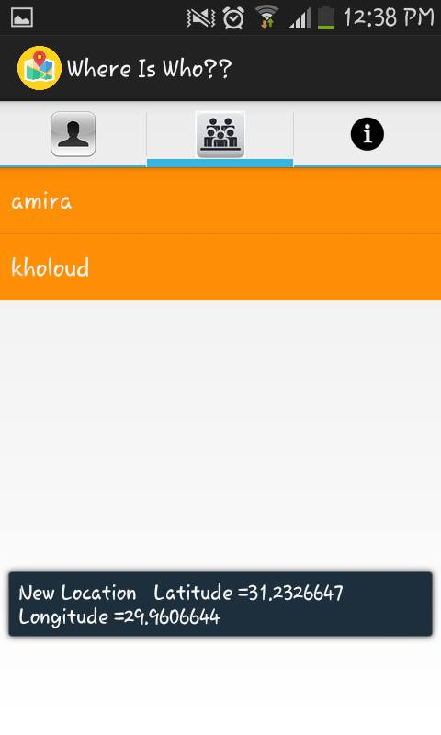

Slide 66
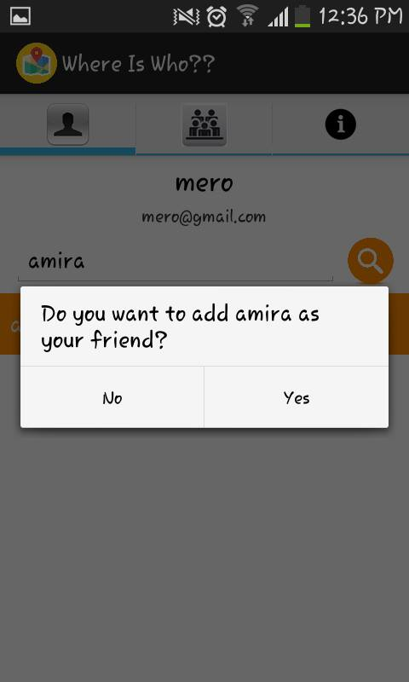

Slide 67
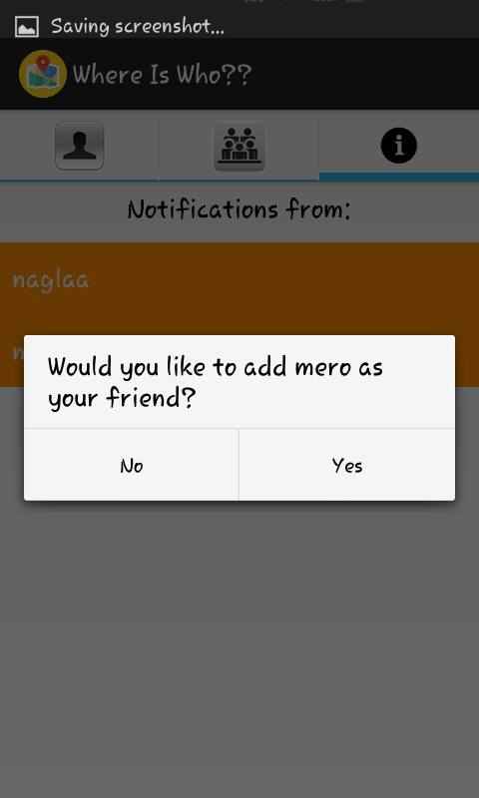

Slide 68
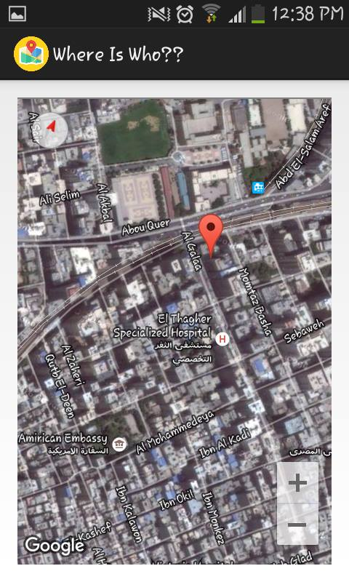

Slide 69
Conclusion
It describe a modular and general Architecture in which a list of available platforms for location based service is included.
One option in this system is to provide Mobile Application connected with database server. The accuracy of the location is the accuracy of the used GPS. The System will improve safety, security, and facilitate supervision process.

Slide 70
Future work
Future improvements to be made to this type of service may include but are not limited to:
Improve the user-interface.
Improvement of access and security of the system.
Make the application compatible with mobile Platforms

Slide 71
Thank you

